Slide 1
Proterm Overview
Bharath Kumar Janardhana

Slide 2
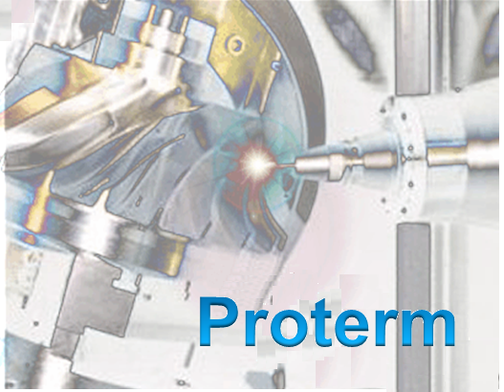
Proterm
Brief Description: Proterm tool manages NC data from various cam sources. It generates, modifies, persists NC programs and upload them to servers, download to machines in powertrain production plants.
Scope of work at MBRDI: Architecture, Development and Testing
Technologies used: Java/JEE , Eclipse RCP, REST, Hibernate, OIDC with GEMS, JBoss, DHC.
Domain: MBC powertrain production and assembly, Tubebending for Cars and Trucks.

Slide 3
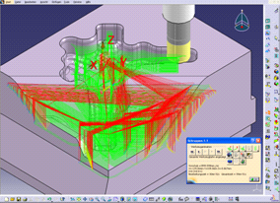
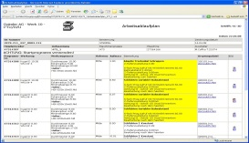
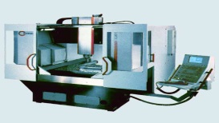

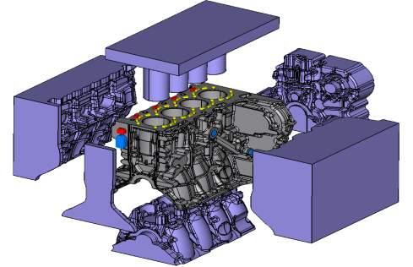



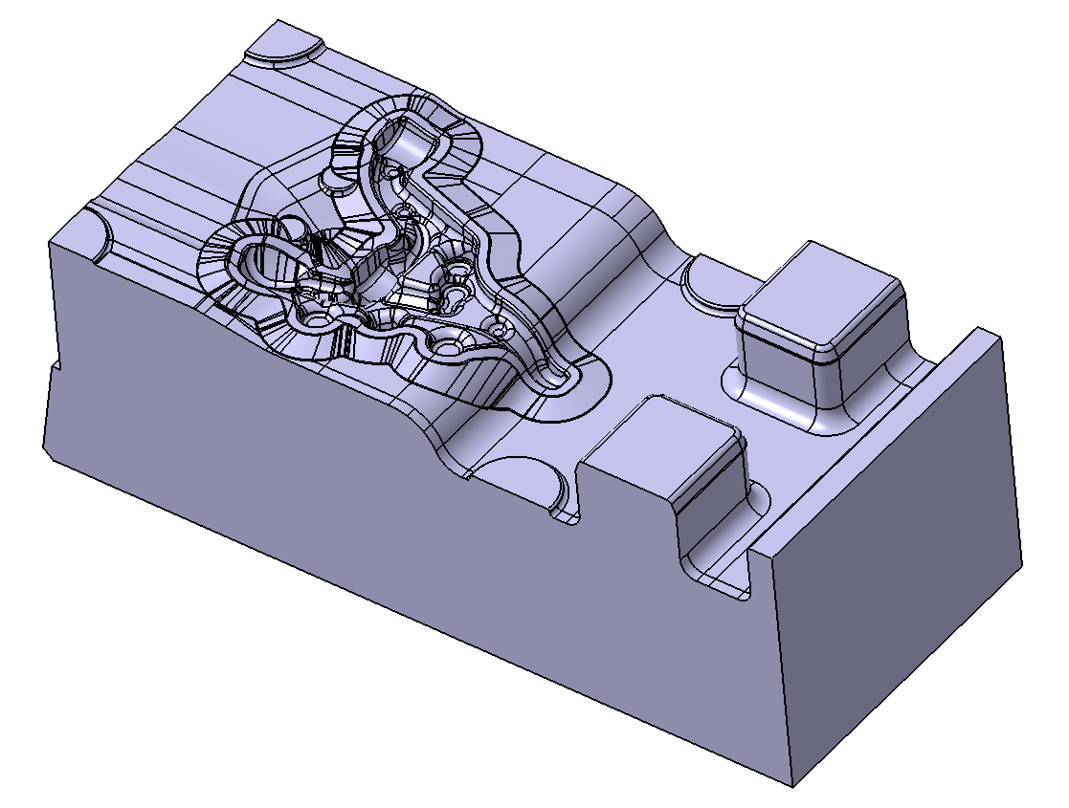
CAM Process Overview
Tool&die
process,
pilot series
CAD
model
NC-planning
&
programming
safeguarding
(via
simulation)
CAM
integration
Post-
processing
& DNC
NC
production
internal
Proterm
approval
internal
external
internal
Series
process
CAD
model
NC-planning
&
programming
safeguarding
(via
simulation)
CAM
integration
Post-
processing
& DNC
NC
production

Slide 4





Proterm (CAM-NT & ProtermSoft)
NC-programming
NC-IPS
TEBIS
WorkNC
hyperForm
CATIA V5
Drahterodieren
Roboterschweißen
Mecanic
Toplas
NC- data management
Proterm
CAM
Integrate different CAM-Systems and generate identic worker information:
list of manufacturing tools
fixture documentation
operating sequence
status of NC program
Optimization list
NC code
NC plot of manufacturing tools
Postprocessing
Smaragd
ABIS2000
NC-IVS/ DNC
NC-production
Proterm
^{Tool & Die,Backup}

Slide 5
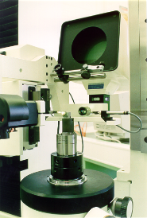
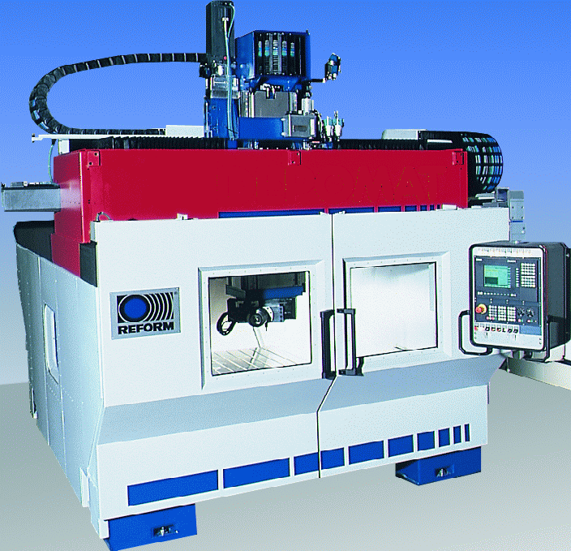
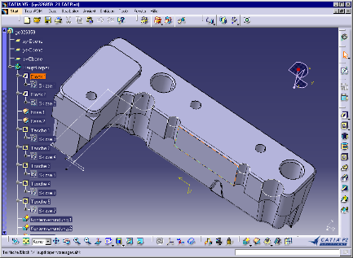
Complete CAM Process Overview
Tool shop
NC-machine
CAM-specific Initfile
CAM-Init Makro
CAM-Systems :
CATIA AMG & LMG
WorkNC
tebis
NX …
CAM-specific documents
Creation of CAM-specific projectpath and Initialsation Data
CAM-Inputdata
initialization
download
upload
CAM-NT
ProtermSoft
NC-management
documents
NC-DB
shopfloor-Documents:
NC-Program
Setup plan
Work flow
Tooling plan
Blueprints
Simulation data
Database-Structure:
partnumber
production plan
operating sequence
....
Creation of
Nc-program
Standadised Shopfloor documents

Slide 6
Proterm Projects
Tool & Die Production
Series Production
Manufacturing of Tools, Dies and Pilot parts in house.
In Production since 2015
Used across more than 15 manufacturing plants in Germany
MBRDI team was involved in Rollouts on the shopfloor.
Also used in Tube Bending Plants for Trucks and Cars (Woerth and Sindelfingen)
Manufacturing of actual Car parts
In Production since 2019
Background Jobs performing scheduled Automatic Backup of Machine Data

Slide 7
2021 and Future Plan
2021
2022
EDC movement to Frankfurt
Technology Upgrade from EJBs to REST APIs
Upgrade to Hibernate
Replacement of PAI clientcontainer
Replacement of PAI RIAD Component
Preparation for Daimler Hybrid Cloud (DHC) migration
EU Data Protection Topics – Part 1
New Tube Bending Process implementation
RUN : Production support for Tool & Die and Series production
EU Data Protection Topics – Part 2
Migration to Daimler Hybrid Cloud
Proterm Mobile App
RUN : Production support for Tool & Die and Series production

Slide 8






Proterm Team
MBRDI
ITO/CE
Sanjay Kamat
(Program Manager)
Ananya Naik
(Senior Developer)
Apurv Jain (Ext)
(Developer)
Shravya Palamasi (Ext)
(QA)
Bharath Janardhana
(Architecture, Tech-Lead)
Gerold Winz
(E4)
Darshan Madihalli
Dieter Engelfried
(Product Owner)

Slide 9
Thank You

